Slide 1
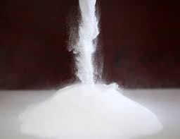
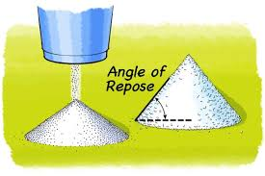
Lab.(3) Powder flow Assistant Lecturer: Aula Jawad

Slide 2
Content
Introduction to powder and powder flow
The reasons for producing free-flowing powder
Particle properties and bulk flow
Factors affecting powder flow
Improvement of powder flowability
Measurement of powder flow
Procedures for flow measurement

Slide 3
Introduction to powder and powder flow
What are the differences between powder and granules?
The pharmaceutical use of powder to produce tablets or capsule
Together with mixing and compression properties, Powder flow is one of the preformulation parameters that is of critical importance in the production of pharmaceutical dosage forms

Slide 4
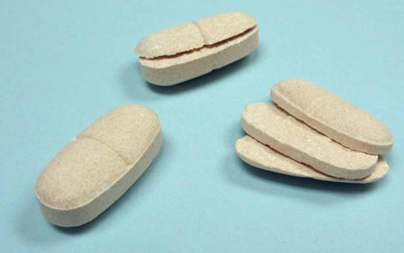
The reasons for producing free flowing powder
Uniform flow from the storage container or hopper to the tablet machine and capsule-filling equipment, allowing uniform particle packing and then constant V/m ratio in order to maintain tablet wt. uniformity
To obtain reproducible filling of tablet die and capsule dosators to obtain consistent physicochemical properties & uniform wt. from tablet to tablet and from batch to batch
Poor powder flow may cause air entrapment and this may promote tablet problems such as capping and lamination

Slide 5
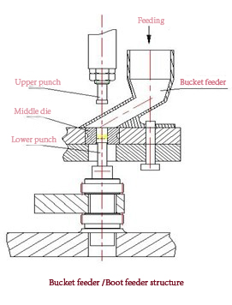
Poor powder flow that results from excess fine powder particles which increase friction between particles and die wall as well as increase dust contamination risk during powder transfer
In addition, there are many industrial processes such as pouring, sieving, mixing, and drying require free-flow powder

Slide 6
Particle properties and bulk flow
Cohesion occurs between like surfaces, such as component particles of bulk solid.
Adhesions occur between two unlike surfaces, for example between a particle and a hopper wall
Cohesion & adhesion are Van der Waals forces that increase as particle size decrease due to an increase in the S.A of particles and then particles contact
Other forces contributing to interparticle cohesion?
Humidity has an effect on the cohesion and adhesion forces.
Notes:
Humidity act as binder and give sticky powder

Slide 7
An equilibrium exists between forces responsible for promoting powder flow (driving forces??) and preventing powder flow (drag forces??)
Some of these factors are modified or controlled by external factors related to particle properties
Particle size
Particle shape
Particle density
Surface morphology
Moisture content
Friction
Consolidate and expanded powder
Notes:
Particles larger 250 is free less100 is bad flow less than 10 resist flow except as large agglomerates

Slide 8
Improvement of powder flowability
Alteration of particle size and size distribution
Alteration of particle shape or texture (spray-drying)
Alteration of surface forces (Reduction of electrostatic charges, frictional contact)
Decrease moisture content (drying)
Formulation additives (flow activators)
Use of force feeder
Use of vibration-assisted hopper
Notes:
The texture of particles may also influence powder flowability, as particles with very rough surfaces will be more cohesive and have a greater tendency to interlock than smooth-surfaced particles.
Colloidal silicon dioxide increases bulk vol so reduces bulk density

Slide 9
Measurement of powder flow
Direct method
1- hopper flow rate
2- recording flowmeter
Indirect method
1- cohesive/adhesive measurement
2- shear strength
3- The angle of repose
4- bulk density measurement
5. Tensile strength

Slide 10
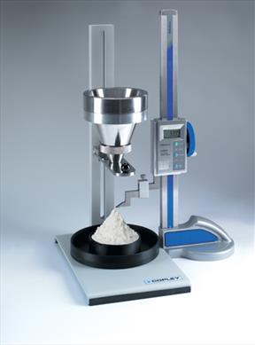
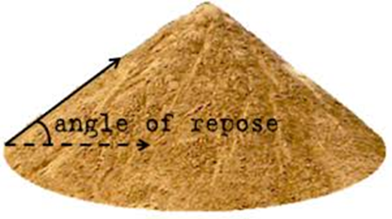
Angle of repose
It is a simple measure of powder flow
When inclination angle > frictional forces the particles begin to slide
When inclination angle < frictional forces the particles stop sliding
The balance between forces causes a powder poured from the container onto the horizontal surface to form a heap.
The angle that formed between the sides of the heap and the horizontal surface is called the angle of repose

Slide 11
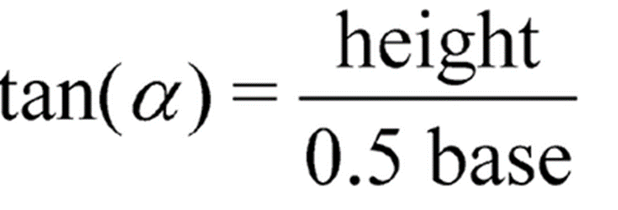
The value of the angle of repose is high if the powder is cohesive ( has bad flow)
The value of the angle of repose is low if the powder is noncohesive ( has good flow)
If the powder is very cohesive the heap may be characterized by more than one angle of repose. ?? Why?? And how to solve this problem?

Slide 13
Measurement methods of angle of repose

Slide 14
Angle of repose is not reliable method for measuring powder flow, why?
Angles of repose have been used as indirect methods of quantifying powder flowability, because of their relationship with interparticle cohesion.
There are many different methods of determining angles of repose ( produce different values for the same powder)
Differences in the way the samples were handled prior to measurement

Slide 15
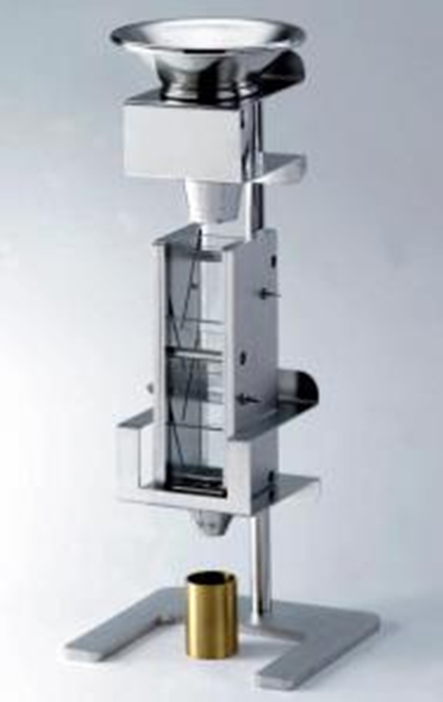
Determination based on bulk density
Powder flow can be determined from initial bulk density (poured bulk density ρpoured )and final bulk density (tapped bulk densityρtapped)
simple, fast, and popular method.
ρpoured ₌ m/ Vₒ
ρtapped ₌ m/ Vf
Use Scott Volumeter to measure the bulk density
( ρpoured )

Slide 16
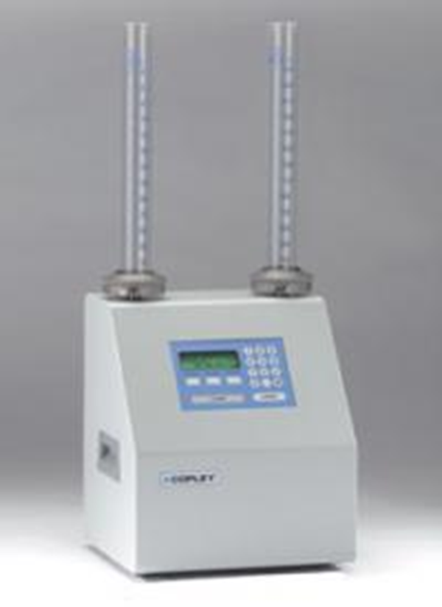
Use the tap density tester to measure tapped density (ρtapped )
Hausner ratio= P _{tapped}/ P _{poured}
Carr’s index =(P _{tapped}- P _{poured})/ P _{tapped})× 100%
Carr’s index is also called the compressibility index
Hausner was related to interparticle friction and, as such, could be used to predict powder flow properties. He showed that powders with low interparticle friction, such as coarse spheres, had ratios of approximately less than 1.2, whereas more cohesive, less free-flowing powders have Hausner ratios greater than 1.5
Factors affecting values of Carr’s index and Hausner Ratio??

Slide 18
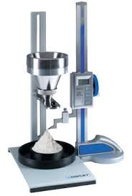
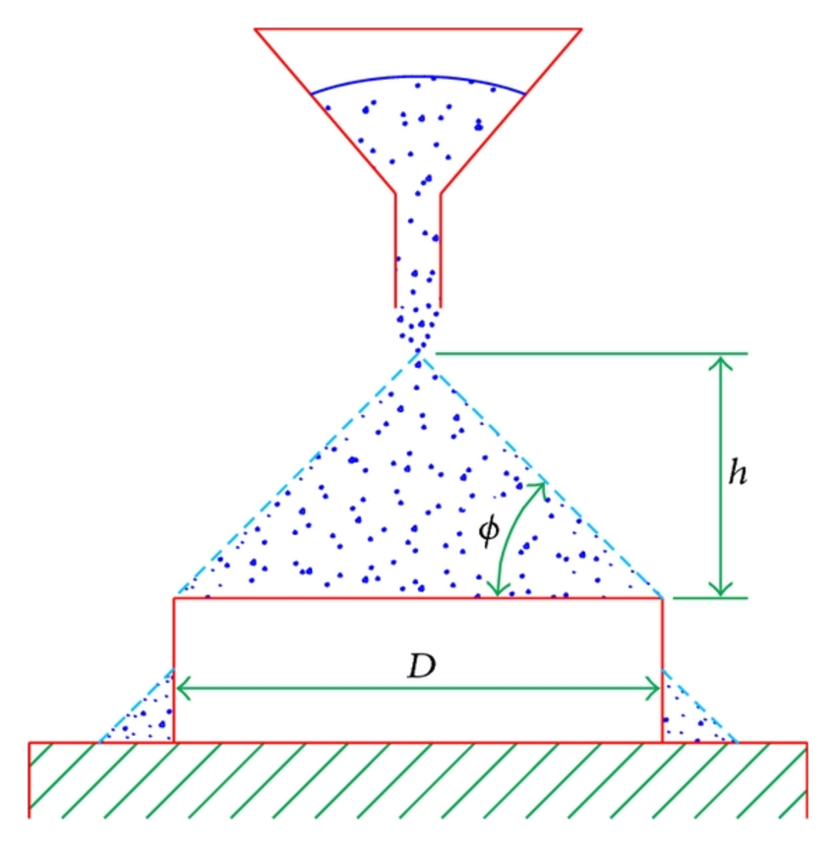
Procedures for flow measurements
Procedure (1) A/ measurement of the angle of repose
Place an excess amount (50-100gm) of powder A and powder B in the funnel.
Make sure the shatter is closed.
Leave the powder for 5 seconds to settle.
Remove any clumps ( avoid grinding)
Open the shatter.
Measure the height and the base of the inverted cone.
Calculate the angle of repose from equation.

Slide 19
Procedure (1) B /measurement of powder flow rate
Repeated the same procedure for angle of repose and measure the time that required for flow.
Report the flow rate as (g/sec)

Slide 20
Procedure (2): Measurement of bulk density
Record the weight of the empty cylindrical cup
Allow an excess of powder to flow through the apparatus into the sample receiving cup until it overflows,
Carefully, scrape excess powder from the top of the cup by smoothly moving the edge of the blade of spatula perpendicular to and in contact with the top surface of the cup.
Remove any material from the side of the cup and determine the mass (m) of the powder
Calculate the bulk density in (g /mL) form (Bulk density (P_{B}) = m/V₀).
6. V₀ = volume of the empty cup=25ml; m =the weight of the powder in the cup

Slide 21
Procedure (3) measurement of tapped density(P_{tapped})
Load the graduated cylinder with 100gm powered sample
Carry out 10, 500, and 1250 taps on the same powder sample and read the corresponding volumes V10, V500, and V1250 to the nearest graduated unit.
If the difference between V500 and V1250 is less than or equal to 2mL, V1250 is the tapped volume.
If the difference between V500 and V1250 exceeds 2mL, repeat in increments such as 1250 taps, until the difference between succeeding measurements is less than or equal to 2mL.
Calculate the tap density (g/ml) by the formula:
Tapped density (P_{tapped)} = weight of the sample (100gm)/ V_{f}
Calculate Hausner ratio & Carr’s index

